Slide 1

Predicting customer segment for
By Yana Pavlenko, Data Scientist

Slide 2
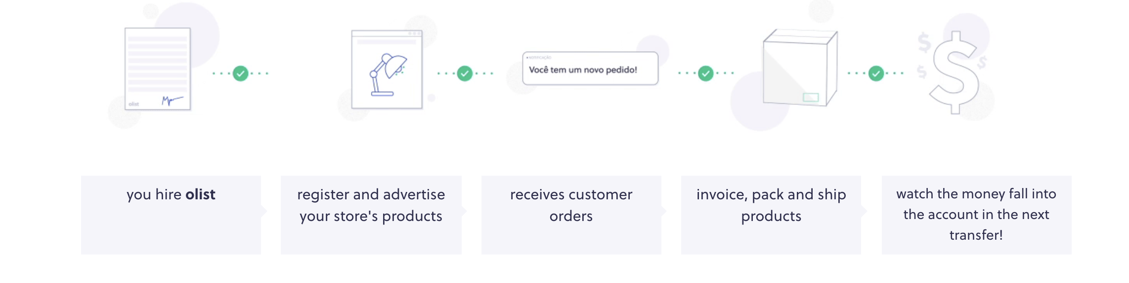
What is
It is a software Start UP
Largest Brazilian online marketplace
More than 2.5 millions of customers

Slide 3
Business question: Can we provide better customer experience on earlier stages? Stakeholders: Tiago Dalvi, Founder of Olist
1
Data Question:
Can we predict customer segment using single order?
2

Slide 4
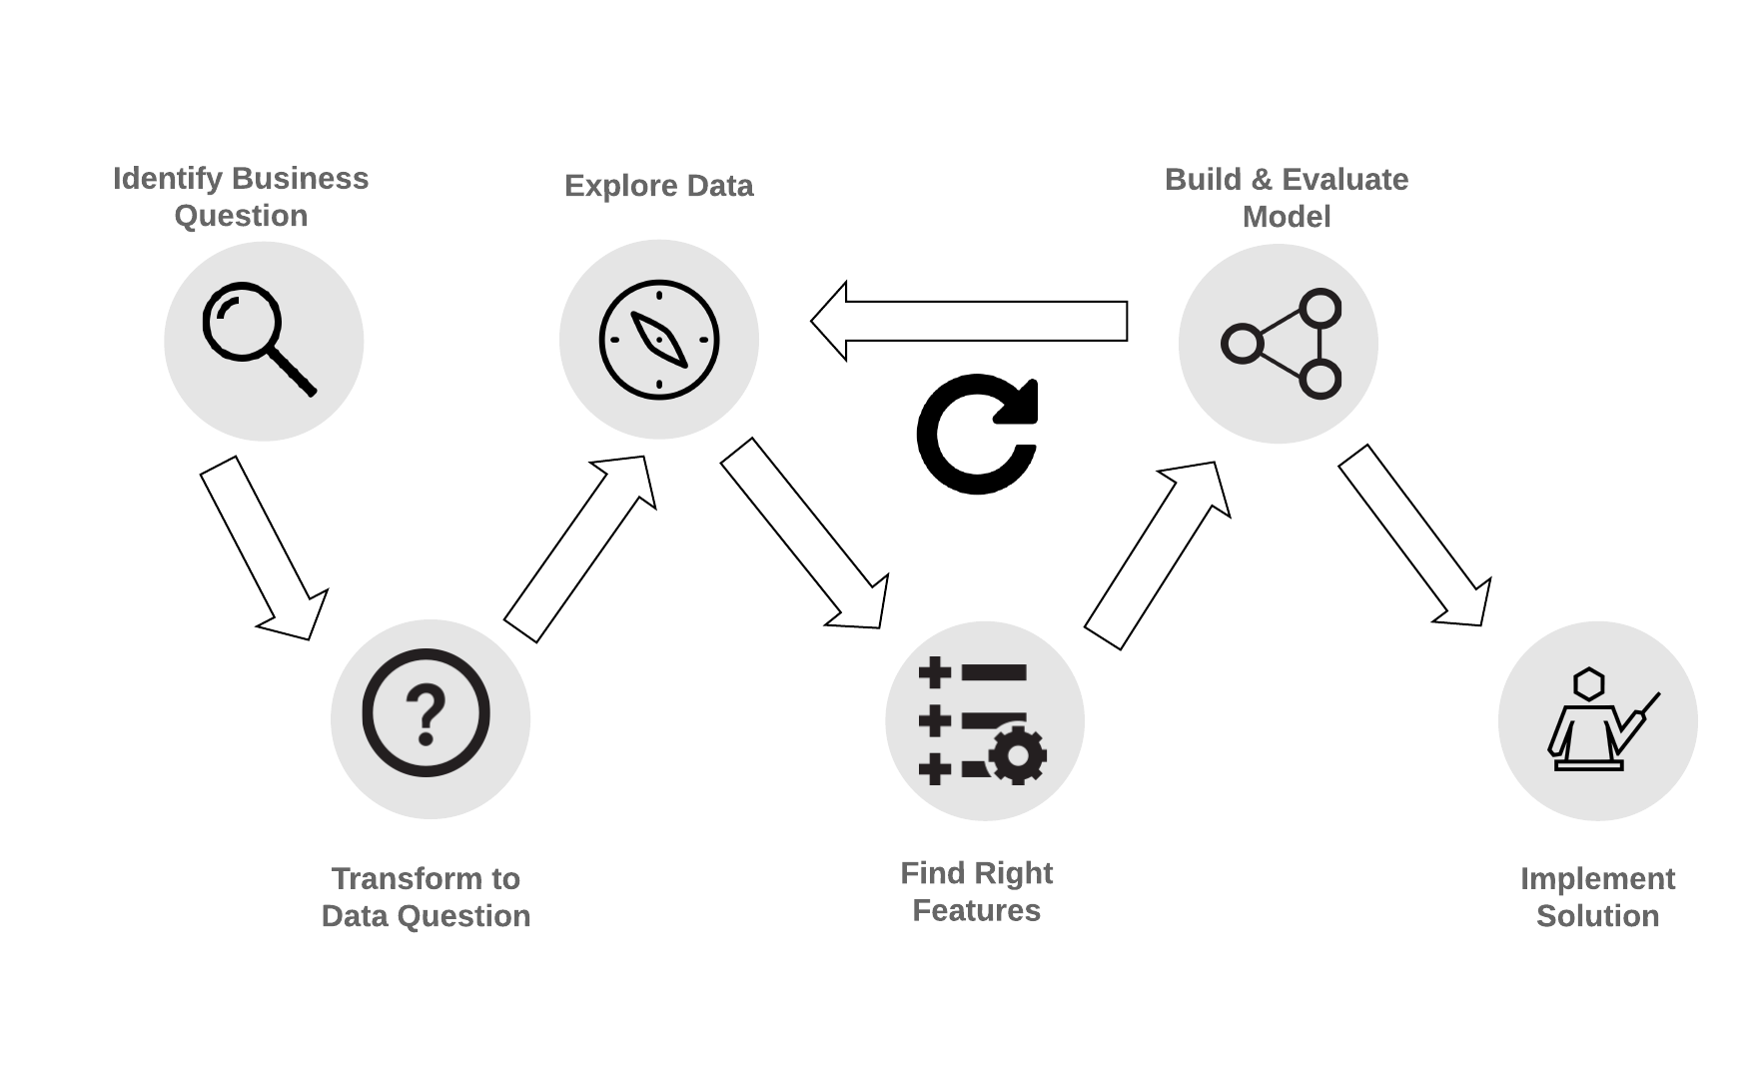

Process flow

Slide 5

Data process design
Data from Kaggle competitions provided by Olist for 100k+ orders

Slide 6
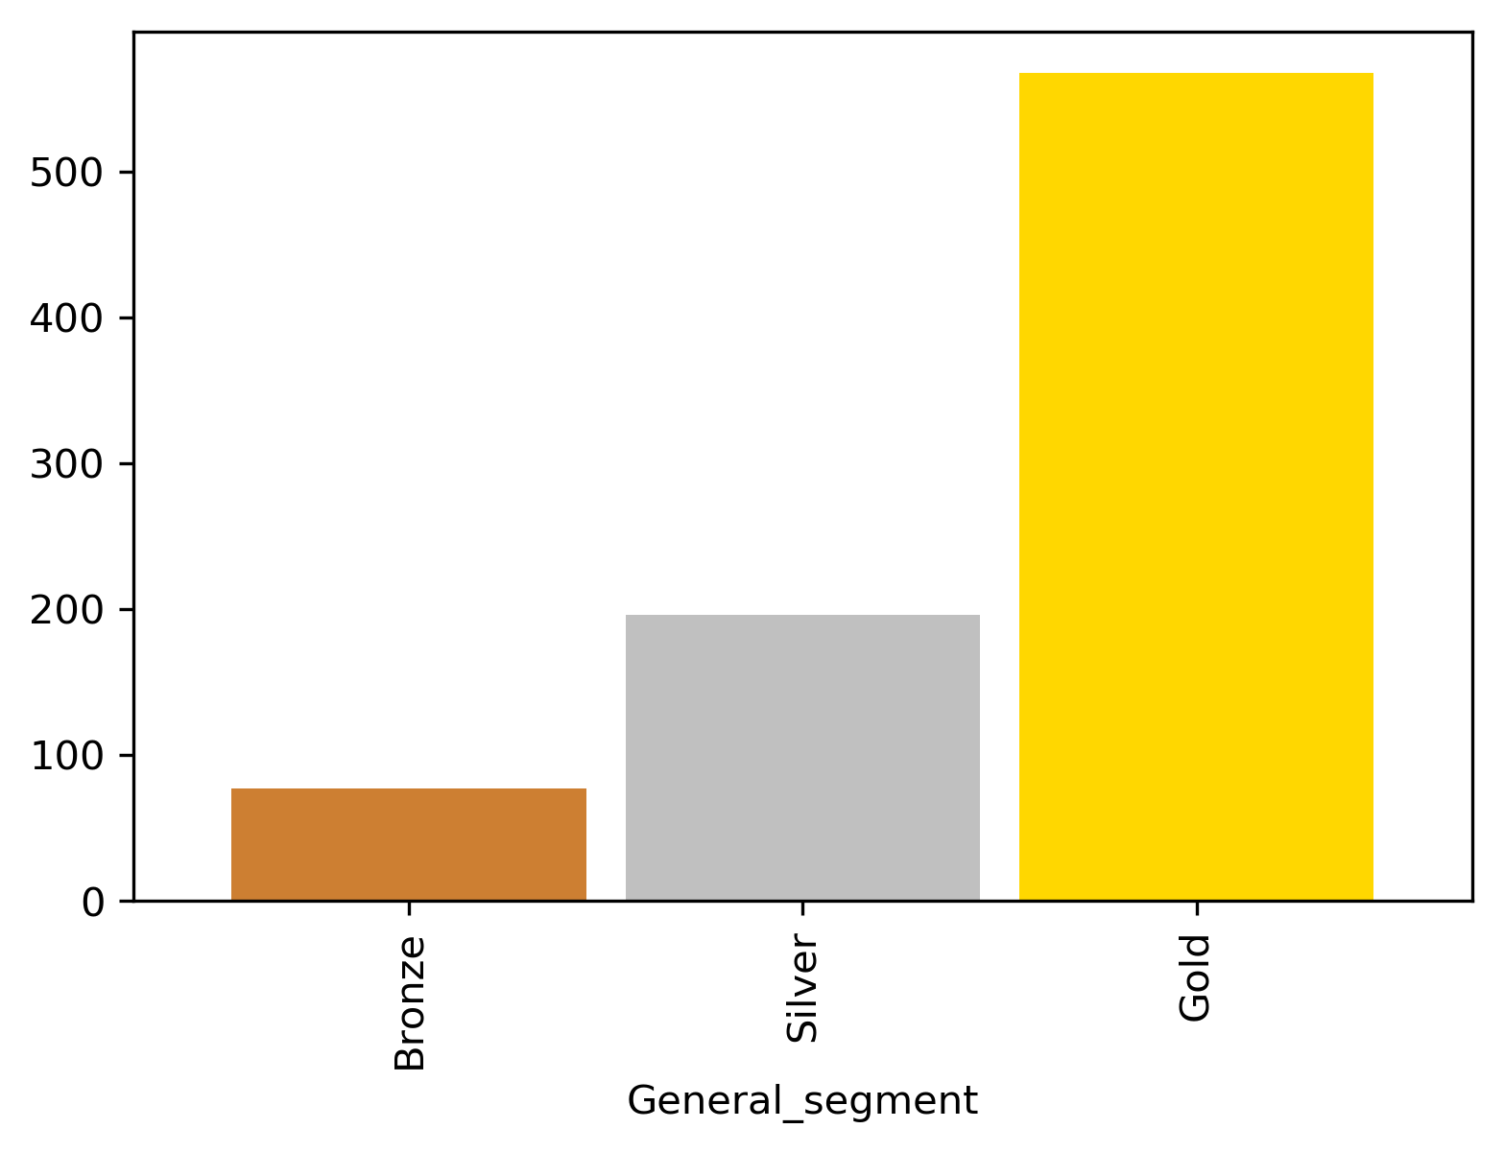
Customers segmentation
Percentage of customers:
Gold 17%
Silver 50%
Bronze 33%
Average value of order, R$
Segment

Slide 7
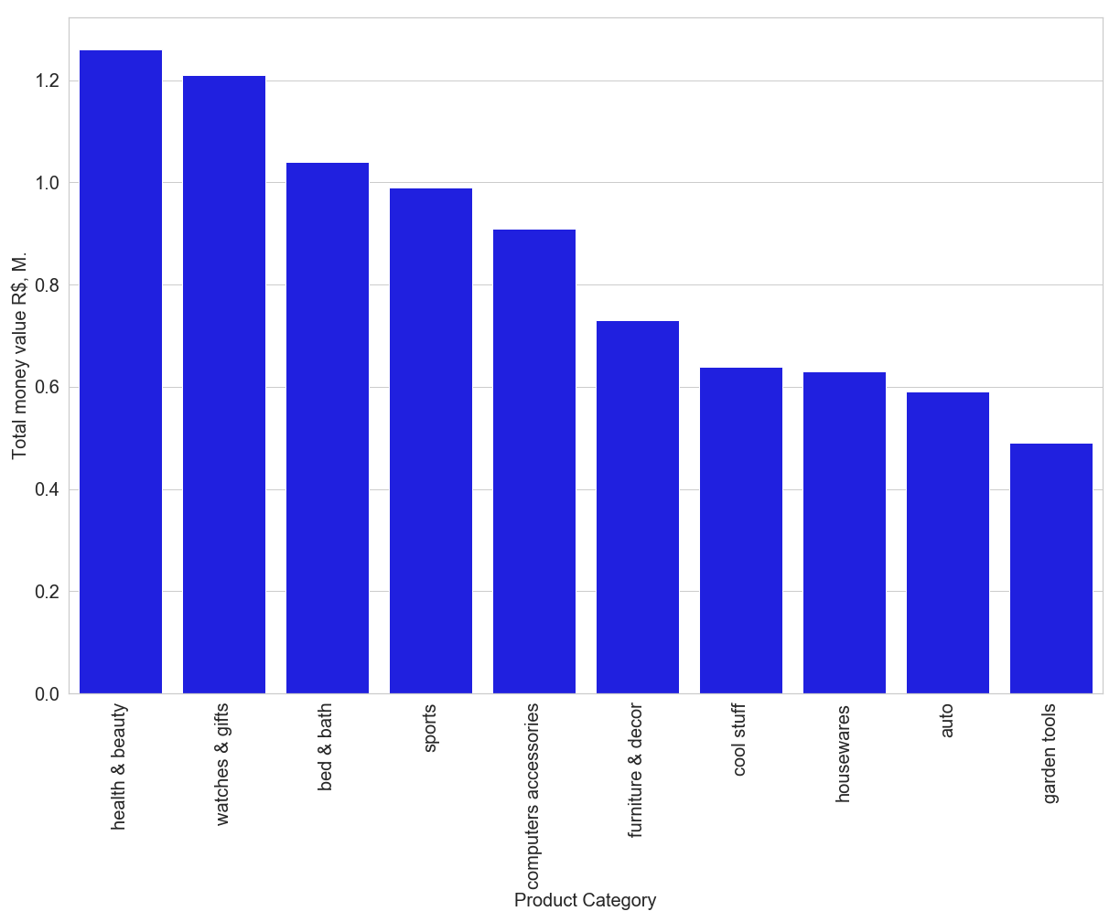
Top 10 Product Categories by orders value
Total value of all orders: 13.6 M.

Slide 8
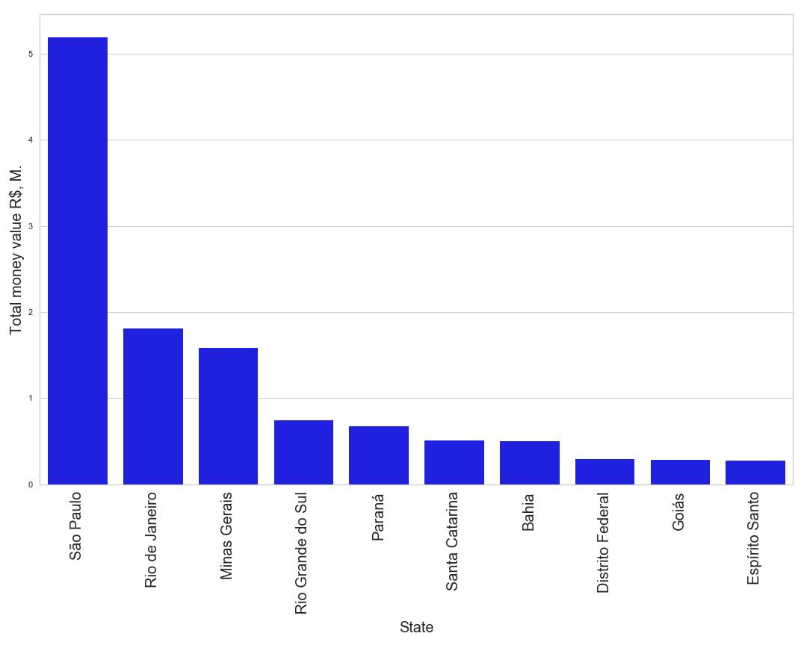
Top 10 States by orders value
Top
Total value of all orders: 13.6 M.

Slide 9
Modeling and evaluating
Model | Accuracy | Precision | Recall
Logistic Regression | 0.656 | 0.65 | 0.65
XGBoost | 0.73 | 0.75 | 0.74
Random Forest | 0.8 | 0.8 | 0.8
Multiclassification models that define 3 classes of segments using 15 features

Slide 10
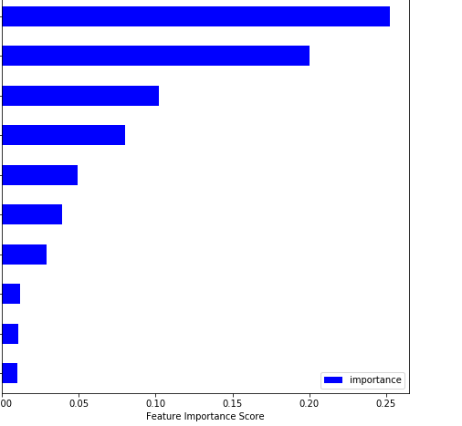
Top 10 features by importance
R$ of order
R$ of delivery
Estimated delivery days
Actual delivery days
Number of items in order
Item description
Review score
Paid w credit card
Customer state
Paid w voucher

Slide 11

Solution & Next Steps
Implement the model and assign segment.
▶︎ ▶︎ ▶︎
Gather more data and provide personalised experience.
Personalised experience:
Loyalty program
Exclusive offers
Free delivery
Vouchers
Data to collect:
Birthday date
Gender
Area of interests

Slide 12
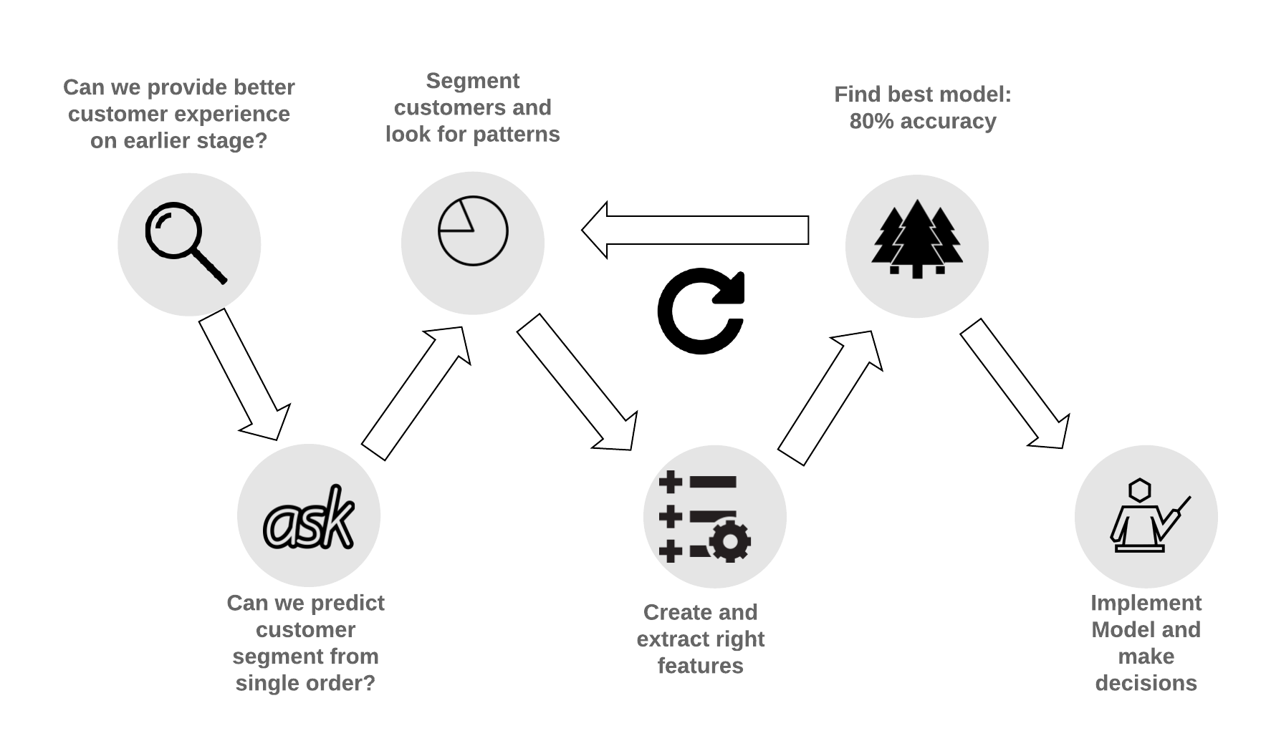
Summary
Improving experience for 10% customers and convert them to the next segment will improve revenue by R$ 2.1 million –from total revenue
Customers with vouchers have more than twice higher returning rate

Slide 13
Thanks!
Any questions?
You can find my project and notebooks at
@https://github.com/PavlenkoYana
EDA: Data exploration
RFM Segmentation: Customers Segmentation
ML Prediction: Feature engineering and Machine Learning

